Slide 1
Maree Michel Bridge GRS-IBS Abutment: Lessons Learned
Jesse G Rauser, PE

Slide 2
Project Overview

Slide 3
Project Overview
Project is located along LA Hwy 91 in Vermilion Parish
Consisted of replacement of two timber bridges over Maree Michel Canal
First GRS abutments designed & constructed for LADOTD projects
Every Day Counts initiative
Designed in-house and let for bidding
Project Location

Slide 4
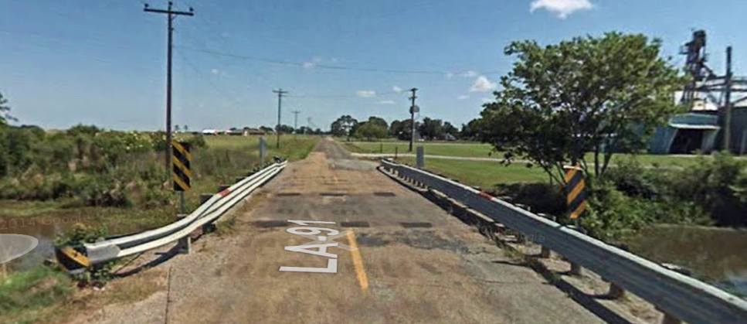
Project Site Selection
Rural setting with low ADT
< 500 vehicles
Relatively short spans
Creek Bridge: 35 ft
Maree Michel Bridge: 72 ft
Bridges span irrigation canals with virtually no flow
Minimal scour concerns
Very little fluctuation in water elevation
Old Maree Michel Bridge
Old Creek Bridge

Slide 5
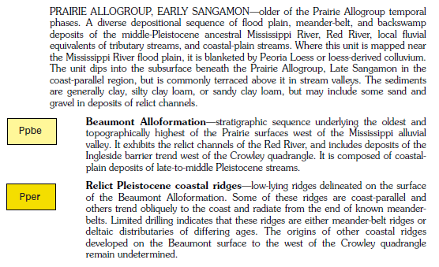
Site Geology
Approx. Site Location
Geological Map of Project Site

Slide 6
Generalized Soil Profile
Clay Su = 1,740 psf, γ = 125 cf
Sandy Silt φ > 30, γ = 122 cf
Clay Su = 2,100 psf, γ = 117 pcf
Clay Su = 1,500 psf, γ = 118 cf
Clay Su = 820 psf, γ = 122 pcf
Undrained Shear Strength and Unit Weight of Foundation Soil Layers

Slide 7
Design

Slide 8
FHWA Implementation Guide
Design commenced with hand calcs closely following the FHWA guide
GRS had to be “sold” to other LADOTD sections (Bridge Design, Project Management)
Chapters 3 (materials), 4 (design), and 7 (construction) were helpful in this regard
Overdesign of bridge to account for perceived weaknesses of the method was discouraged
FHWA-HRT-11-026

Slide 9
Stability Analysis Spreadsheet
Back and forth with Bridge Design section required iterative approach
Span configuration
Loads & moments
Beam seat size
A spreadsheet was developed for the GRS design
Quickly accommodated minor changes in structural design
Allowed for parametric studies to get a feel for sensitivity of the design to various factors
LADOTD GRS Analysis Spreadsheet

Slide 10
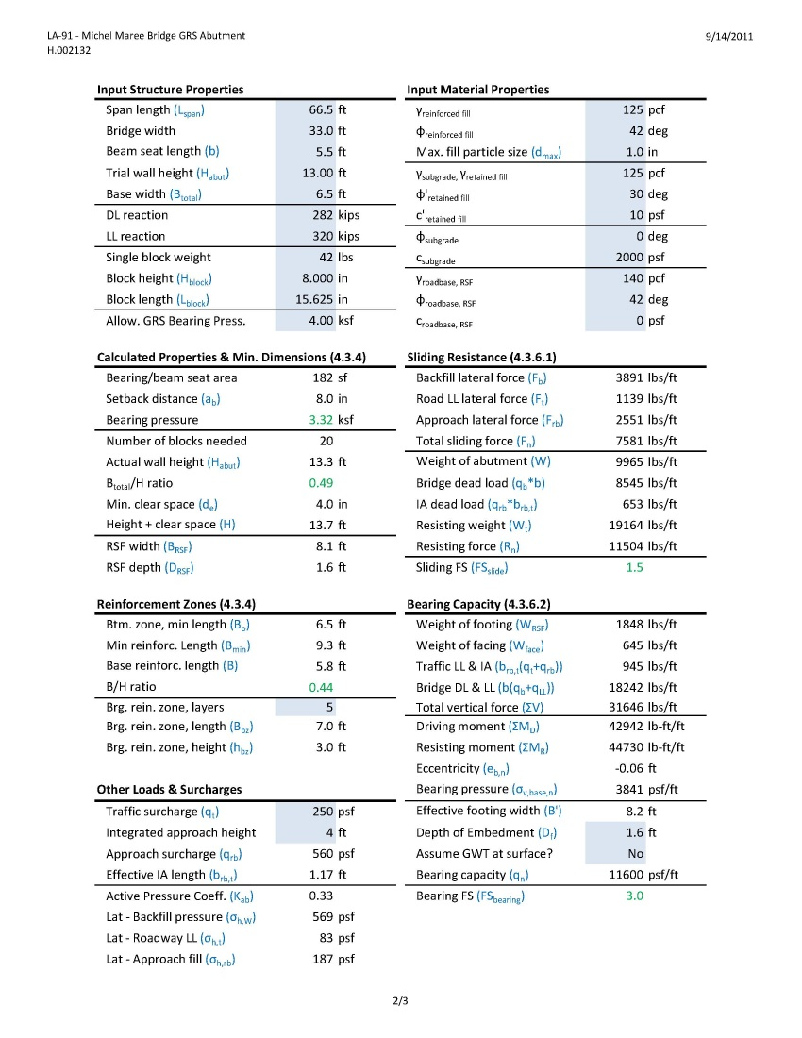
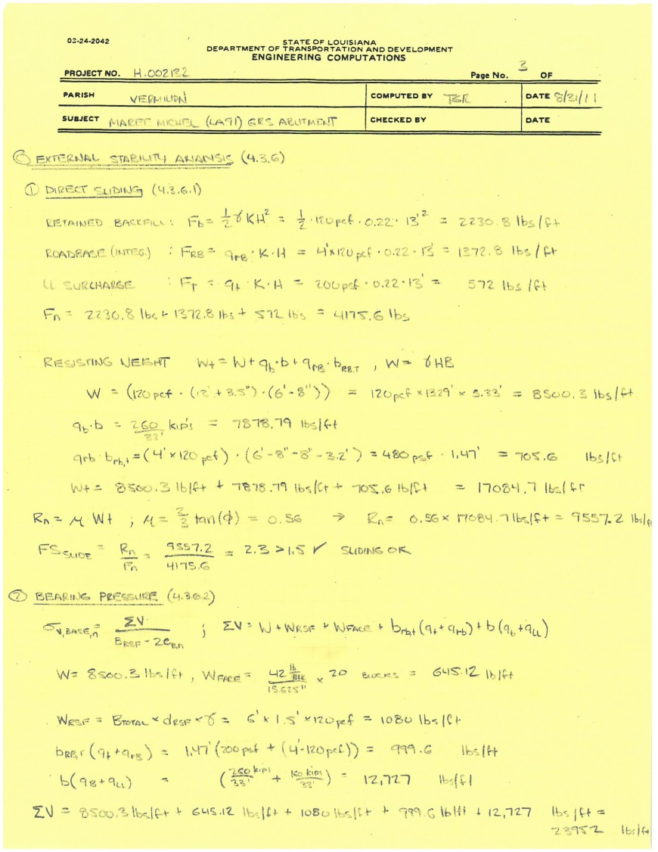
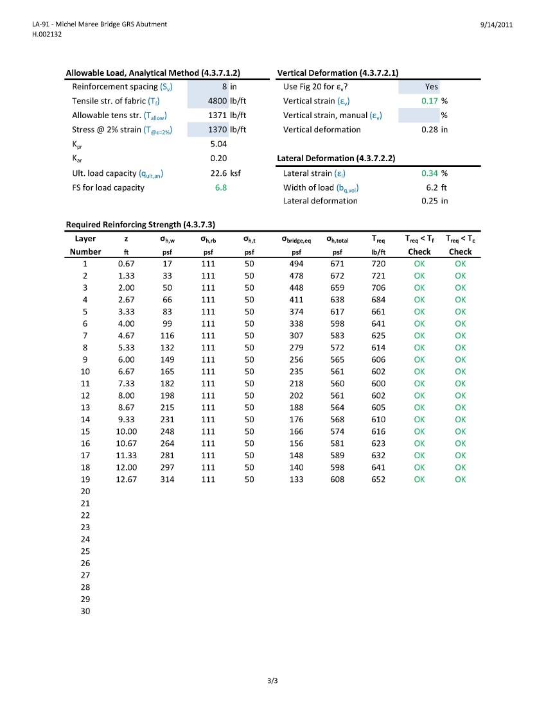
Stability Analysis Spreadsheet

Slide 11
Specifications & Bids

Slide 12
Specifications
FHWA guide spec was finalized in August 2012
Unfortunately, we began writing our spec in June 2012
LADOTD spec was based on:
Our existing MSE wall spec
FHWA Implementation Guide
Other states’ GRS specs
Using the guide spec would have been MUCH easier
FHWA-HRT-12-051

Slide 13
Specification Writing Challenges
Separating guidelines from necessary specifications
This is difficult when you haven’t actually built one yet!
Leave flexibility for a method type spec (i.e., backfill compaction)
Deciding what needs to go in the specification vs. plans
This took several iterations based on FHWA and LADOTD feedback
Leave flexibility for different facing elements
Writing for a specific audience
Spec for a contractor is different than one written for in-house forces
Allow District construction inspectors and engineers to review plans & specs
In hindsight, the specification should have erred on the side of being more prescriptive
Addressing the availability of materials or new materials
Approved products list?

Slide 14
September 2013 Letting
Bids came back high
DOTD Estimate: $1.9M
High Bidder: $3.5M
Low Bidder: $3.0M
Contractor comments:
Unfamiliar type of work
Solid blocks & stained blocks too costly/difficult to obtain
75-day project duration too tight
Stone backfill in spec was not readily obtainable
Wingwall details unclear
Plans & specs were modified based on contractor feedback
Stained blocks removed
Hollow blocks added
Project duration increased to 90 days
Backfill specs changed
Additional wingwall details added to plans
Scheduled mandatory pre-bid meeting with FHWA expert
Intent was to decrease unit cost of GRS pay item

Slide 15
Aggregate Gradation Specification
LADOTD Standard Spec book has Grades A-F for stone
All gradations were compared to AASHTO 89 stone
Grade F matched AASHTO 89 very closely
Grade F was selected for 1st spec
Contractors were not familiar with Grade F stone
For reletting, a Grade A stone was specified (similar to #57)

Slide 16
CMU Block Specification
Tried to reduce block spec from 4,000 psi to 1,900 psi (ASTM C 90)
4,000 psi may not be critical in a non-shrink swell environment
Local FHWA office rejected the spec change, because
FHWA Implementation Guide recommends 4,000 psi
Quote from semi-local supplier suggested no cost difference between 4,000 psi and 1,900 psi blocks
Hollow CMU Blocks

Slide 17
March 2014 ReLetting
Bids still came back high
DOTD Estimate: $2.2M (116%)
Increase partially due to correcting a mistake in the GRS unit cost estimate
High Bidder: $4.0M (114%)
Low Bidder: $3.1M (103%)
Low bidder’s unit cost for GRS was $150/sf for both bids
Difference of 4 to 5 times LADOTD estimate
Even after addressing Contractor feedback, no change
Only traditional bridge (i.e., pile driving) contractors bid on the project
Were bids intentionally high?
Would earthwork contractors have been more competitive?
First comment at pre-bid meeting “Can we VE driven piles instead?”
No technical questions were asked (as usual)
Project was awarded to low bidder in spite of high bids

Slide 18
Construction

Slide 19
Cofferdam
Although channel was mostly static, too deep for earthen dams
Cofferdam was required
Permit stipulated that canal could not be fully blocked
Separate cofferdams for each side of abutment
Cofferdam Estimate
Low Bidder: $65K
High Bidder: $365K
Building RSF Inside Cofferdam

Slide 20
Cofferdam
Was there confusion among contractors as to the best dewatering strategy?
Low bidder claimed permit wasn’t available for review early enough
Cofferdams impacted construction schedule
Did the low bidder underestimate the dewatering requirements for the project?
Compacting Lift Inside Cofferdam

Slide 21
CMU Block Alignment
First abutment had block alignment problems
Tilting out of plumb
Sliding away from abutment during compaction
Contractor’s request to grind blocks & use shims was initially rejected
We first ruled out
First row - was placed carefully & surveyed
Block tolerances - were OK
Constructing First Row

Slide 22
CMU Block Alignment
Method spec did not force adherence to good practices from the Implementation Guide
Hand tamping
Walking on top of blocks
LADOTD Recommendations
Improve compaction methods
Grind & shim only when needed
Improved compaction methods fixed most problems
Using solid blocks on the 2nd bridge reduced sliding
Flexibility for field engineer to modify method spec helped to achieve a better product
Compacting Against CMU Blocks

Slide 23
CMU Block Integrity
Block supplier provided certs at beginning of project
Showed passing block strength
Blocks delivered to site showed damage
Some were cracked on pallet
Others cracked during construction
Spec only required certs, no regimented QA/QC plan
Local FHWA office requested independent testing after visiting site
Hollow CMU Compressive Strength Cert.

Slide 24
CMU Block Integrity
LTRC tested hollow and solid blocks in Aug & Sept 2015
All blocks < 4,000 psi
Hollow blocks < 1,900 psi
Contractor did not furnish results
Contractor: spec was confusing
Required 4,000 psi strength in addition to ASTM C 90
Thus, 1,900 psi should be used
LTRC and Contractor’s lab tested again in Nov 2015
Hollow blocks < 4,000 psi
Solid blocks passed
Date | Block | Compressive Strength (psi)
Tested | Type | Tested | Required | Ratio
Aug-15 | Hollow | 1490 | 4000 | 37%
 | Solid | 2370 | 4000 | 59%
Sep-15 | Hollow | 1650 | 4000 | 41%
 | Solid | 3110 | 4000 | 78%
Nov-15 | Hollow | 2670 | 4000 | 67%
 | Hollow | 2600 | 4000 | 65%
 | Hollow * | 2817 | 4000 | 70%
 | Solid * | 4492 | 4000 | 112%
CMU Compressive Strength Test Results
* Contractor’s Independent Lab

Slide 25
CMU Block Integrity
Lack of transparency from Contractor led to 1st bridge being completed before issue could be resolved
Contractor’s pay will be penalized
Contractor must grout all cracked hollow blocks
Hollow blocks were rejected for 2nd bridge
Contractor was allowed to use solid blocks at no added cost
Cracked Blocks Delivered to Site

Slide 26
Bearing Bed Reinforcement
Contractor forgot to install bearing bed reinforcing
“Can we just leave this out?”
Had to cut geosynthetic to avoid deconstructing the abutment completely
Seams were staggered vertically
Clearly a case of field personnel not reading the Implementation Guide or plans
Yes, the Contractor asked for extra time as a result!
GRS Profile Detail – Bearing Bed Reinforcing

Slide 27
Approach Construction
Contractor tore out approaches early in project
Brought in wet material which delayed subgrade prep
GRS schedule affected due to concurrent approach work
Delays spread to all phases of the project
Contractor submitted several claims for extra time
YouTube video from the pre-bid meeting was “misleading”
Looking South Along Hwy 91 from Cofferdam

Slide 28
Lessons Learned (DESIGN)
Follow the Implementation Guide
Use a spreadsheet to get a handle on the sensitivity of the GRS abutment to changes in various design parameters
Help educate the Department about the project
Discourage overdesign just because it’s a “new” technology
Provide Implementation Guide to Bridge Engineers & Project Managers
We are considering additional GRS implementation as a result of success in this regard

Slide 29
Lessons Learned (Specifications)
Use the FHWA guide spec as much as possible!
Let experienced district/field personnel review plans & specs
Separate specs from guidelines, plans versus specs
Leave flexibility for experienced field personnel to enforce/modify method compaction spec if needed
Make spec relevant locally
Climate concerns
Material availability
Make sure local FHWA reps are in touch with FHWA subject matter experts

Slide 30
Lessons Learned (Bids)
Hold a mandatory pre-bid meeting
Inform potential bidders that a YouTube video is not the basis for a bid
Make earthwork contractors aware of the project letting

Slide 31
Lessons Learned (Construction)
For pilot project, select a site that is easy to dewater
Enforce compaction spec
Require certain best practices such as hand tamping and walking on blocks – referring to Implementation Guide is not enough
Since a method spec is harder to quantify with records, make sure the inspector is experienced
Discourage modifications to the blocks as substitute for good compaction
Incorporate a detailed QA/QC plan for the facing elements
Have a mechanism to reject facing elements in the field
Review plans and specs with contractor on a regular basis

